Slide 1
IMAGE CLASSIFICATION USING CONVOLUTIONAL NEURAL NETWORK
Guided By : Mr. MANOJ M
ASSISTANT PROFESSOR
COMPUTER SCIENCE
Presented By : ABDUL MANAF
KIRAN R
PIOUS PAUL
VISHNU P.S

Slide 2
ABSTRACT
Image classification model using a convolutional neural network with Tensor Flow.
A multi-category image data set has been considered for the classification.
The classifier train this proposed classifier to calculate the decision boundary of the image dataset.
The data in the real world is mostly in the form of unlabeled and unstructured format. These unstructured images are need to be classified .
Thus CNN is introduced for image classification.

Slide 3
OBJECTIVE
To classify the images according to the category which belong from a large set of different images from different categories .
Sort the image in separate folders according to their names.

Slide 4
INTRODUCTION
Image classification plays an important role in computer vision, it has a very important significance in our study, work and life.[4]
Image classification is process including image preprocessing, image segmentation, key feature extraction and matching identification.
With the latest figures image classification techniques, we not only get the picture information faster than before, we apply it to scientific experiments.
[4] Krizhevsky A, Sutskever I, Hinton G E. ImageNet Classification with Deep Convolutional Neural Networks[J]. Advances in Neural Information Processing Systems, 2012, 25(2):2012.

Slide 5
Existing system
Image classification using SUPPORT VECTOR MACHINE , RANDOM FOREST algorithm which is available on online platforms.[10]
These algorithms are highly complicated and time consuming for processing and classifying images.
Several key parameters should be correctly set to achieve best classification result.
[10] Xavier Mu ̃nozComputer Vision GroupUniversity of Gironaxmunoz@eia.udg.es, Anna BoschComputer Vision GroupUniversity of Gironaaboschr@eia.udg.es,Image Classification using Random Forests and Ferns.

Slide 6
PROPOSED SYSTEM
An image classifier using convolutional neural network,which use CIFAR-10 dataset for image classification.
Classifies the images with more accuracy.
Classifies and save the images in separate folders according to the class it goes.

Slide 7
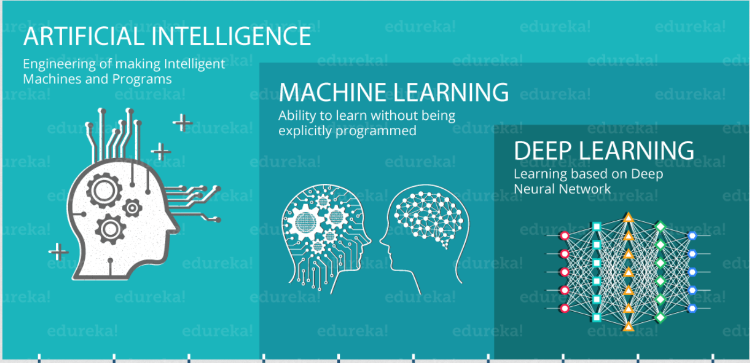
LITERATURE REVIEW
DEEP LEARNING AND IMAGE CLASSIFICATION
Deep learning is part of a broader family of machine learning methods based on the layers used in artificial neural networks.[4]
.
[4] Krizhevsky A, Sutskever I, Hinton G E. ImageNet Classification with Deep Convolutional Neural Networks[J]. Advances in Neural Information Processing Systems, 2012, 25(2):2012.

Slide 8
LITERATURE REVIEW
Convolutional neural network
Convolutional neural network is one of the main categories to do images recognition, images classifications. Objects detections, recognition faces etc.[6]
It has 5 layers.
Input layer
Convolutional layer
Pooling layer
Fully connected layer.
Output layer.
[6] N. Kalchbrenner, E. Grefenstette, and P. Blunsom, “A convolutional neural network for modelling sentences,” arXiv preprint arXiv:1404.2188, 2014.

Slide 9
LITERATURE REVIEW
CNN TRAINING
A part of data set is given to the training process of the network [11].
Training process is the state at which the network is learning the training data.
The training data set is used to train the network. After completing training a model is created.
[11] Image Classification via Support Vector Machine Xiaowu Sun1, Lizhen Liu1, Hanshi Wang1, Wei Song1, Jingli Lu2 1 Information and Engineering College, Capital Normal University, Beijing 100048, P. R. China 2 Agresearch Ltd, New Zealand

Slide 10
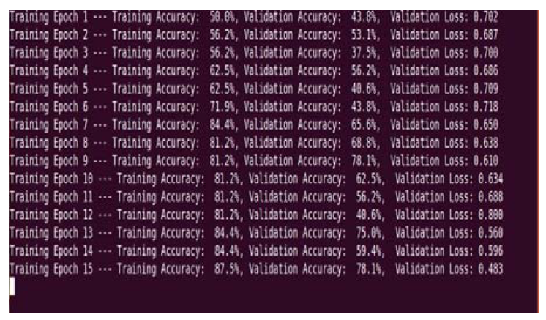
LITERATURE REVIEW
EPOCH
An epoch is one complete presentation of the data set to be learned to a learning machine.[11]
[11] Image Classification via Support Vector Machine Xiaowu Sun1, Lizhen Liu1, Hanshi Wang1, Wei Song1, Jingli Lu2 1 Information and Engineering College, Capital Normal University, Beijing 100048, P. R. China 2 Agresearch Ltd, New Zealand

Slide 11
LITERATURE REVIEW
CNN MODEL
A model is generated after the training of the CNN[11].
A pre-trained model is a model that was trained on a large benchmark dataset to solve a problem similar to the one that we want to solve.
[11] Image Classification via Support Vector Machine Xiaowu Sun1, Lizhen Liu1, Hanshi Wang1, Wei Song1, Jingli Lu2 1 Information and Engineering College, Capital Normal University, Beijing 100048, P. R. China 2 Agresearch Ltd, New Zealand

Slide 12
LITERATURE REVIEW
CNN TESTING
In this stage the performance of the network is measured.[13]
The test dataset is used for the testing
Accuracy is the closeness of actual output and desired output
Error is the variation in between the actual output and desired output
In deep learning, a convolutional neural network is a class of deep neural network.
[13] Impact of Training and Testing Data Splits on Accuracy of Time Series Forecasting in Machine Learning Ramesh Medar Vijay S. Rajpurohit-Rashmi. B.

Slide 13
LITERATURE REVIEW
DATA SET
A collection of images in various categories with meta data[13].
It contains training and testing data.
Image dataset may consist of full of images and its .csv files.
[13] Impact of Training and Testing Data Splits on Accuracy of Time Series Forecasting in Machine Learning Ramesh Medar Vijay S. Rajpurohit-Rashmi. B.

Slide 14
LITERATURE REVIEW
CIFAR-10
The CIFAR-10 dataset consists of 60000 32x32 color images in 10 classes, with 6000 images per class. There are 50000 training images and 10000 test images.[14] The dataset is divided into five training batches and one test batch, each with 10000 images.
The test batch contains exactly 1000 randomly-selected images from each class.
The training batches contain the remaining images in random order, but some training batches may contain more images from one class than another. Between them, the training batches contain exactly 5000 images from each class.
[14] Preprocessing for Image Classification by Convolutional Neural Networks Kuntal Kumar Pal, Sudeep K. S IEEE International Conference On Recent Trends In Electronics Information Communication Technology, May 20-21, 2016, India

Slide 15
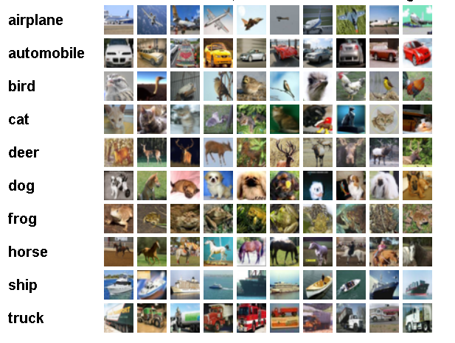
LITERATURE REVIEW
Here are the classes in the dataset, as well as 10 random images from each:
.
[14] Preprocessing for Image Classification by Convolutional Neural Networks Kuntal Kumar Pal, Sudeep K. S IEEE International Conference On Recent Trends In Electronics Information Communication Technology, May 20-21, 2016, India

Slide 16
LITERATURE REVIEW
FEATURE MAP
The feature map is the output of one filter applied to the previous layer.
A given filter is drawn across the entire previous layer, moved one pixel at a time.[14]
Each position results in an activation of the neuron and the output is collected in the feature map.
[14] Preprocessing for Image Classification by Convolutional Neural Networks Kuntal Kumar Pal, Sudeep K. S IEEE International Conference On Recent Trends In Electronics Information Communication Technology, May 20-21, 2016, India

Slide 17
LITERATURE REVIEW
PREPROCESSING
Raw data if applied to any classification methods does not produce good accuracy as can be verified from the results we achieved.[14]
The goal is to show how much the accuracy varies with the application of some well-known preprocessing techniques on some simple convolutional networks.
[14] Preprocessing for Image Classification by Convolutional Neural Networks Kuntal Kumar Pal, Sudeep K. S IEEE International Conference On Recent Trends In Electronics Information Communication Technology, May 20-21, 2016, India

Slide 18
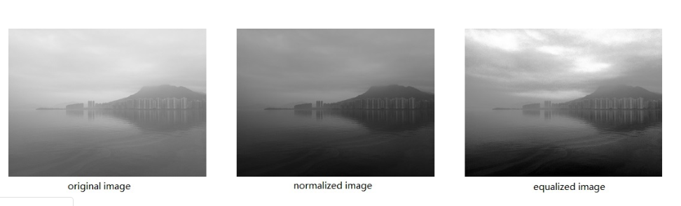
LITERATURE REVIEW
NORMALIZATION
Normalization is a technique often applied as part of data preparation for machine learning.
[14] Preprocessing for Image Classification by Convolutional Neural Networks Kuntal Kumar Pal, Sudeep K. S IEEE International Conference On Recent Trends In Electronics Information Communication Technology, May 20-21, 2016, India

Slide 19

SYSTEM ARCHITECTURE
MODULE DESCRIPTION
INPUT
TRAINING
CLASSIFICATION
B.Tech Bachelors Research Project: 2015-2019
19

Slide 20
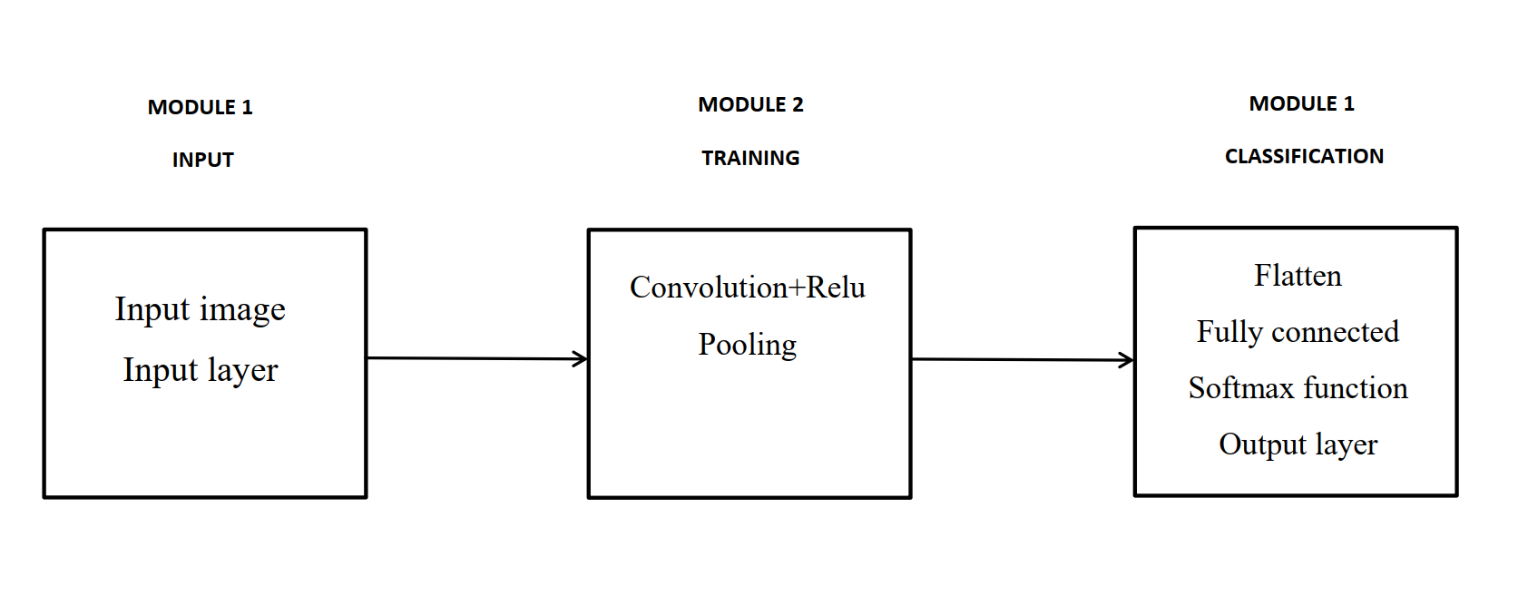
SYSTEM ARCHITECTURE
MODULE DESCRIPTION
Block diagram
B.Tech Bachelors Research Project: 2015-2019
20

Slide 21

SYSTEM ARCHITECTURE
B.Tech Bachelors Research Project: 2015-2019
21

Slide 22
SYSTEM ARCHITECTURE
MODULE 1
Input image
Computers sees an input image as array of pixels and it depends on the image resolution.
Based on the image resolution, it will see h x w x d( h = Height, w = Width, d = Dimension)
B.Tech Bachelors Research Project: 2015-2019
22

Slide 23
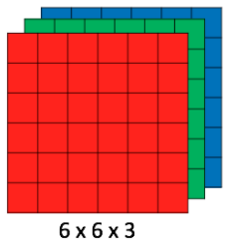
SYSTEM ARCHITECTURE
An image of 6 x 6 x 3 array of matrix of RGB (3 refers to RGB values)
B.Tech Bachelors Research Project: 2015-2019
23

Slide 24
SYSTEM ARCHITECTURE
MODULE 2
CONVOLUTIONAL LAYER
Convolution is the first layer to extract features from an input image.
Convolution preserves the relationship between pixels by learning image features using small squares of input data.
It is a mathematical operation that takes two inputs such as image matrix and a filter or kernal.
B.Tech Bachelors Research Project: 2015-2019
24

Slide 25
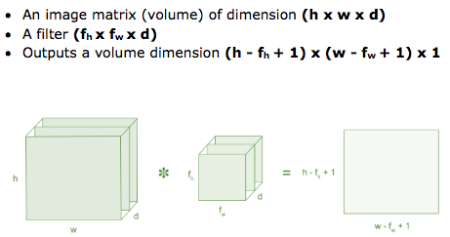
SYSTEM ARCHITECTURE
B.Tech Bachelors Research Project: 2015-2019
25

Slide 26
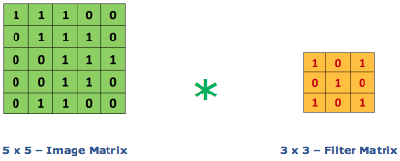
SYSTEM ARCHITECTURE
The convolution of 5 x 5 image matrix multiplies with 3 x 3 filter matrix which is called “Feature Map”
B.Tech Bachelors Research Project: 2015-2019
26

Slide 27
SYSTEM ARCHITECTURE
B.Tech Bachelors Research Project: 2015-2019
27

Slide 28
SYSTEM ARCHITECTURE
PADDING
Sometimes filter does not fit perfectly fit the input image. We have two options:
Pad the picture with zeros (zero-padding) so that it fits
Drop the part of the image where the filter did not fit. This is called valid padding which keeps only valid part of the image.
B.Tech Bachelors Research Project: 2015-2019
28

Slide 29
SYSTEM ARCHITECTURE
NON LINEARITY (RELU)
ReLU stands for Rectified Linear Unit for a non-linear operation. The output is ƒ(x) = max(0,x).
Why ReLU is important : ReLU’s purpose is to introduce non-linearity in our ConvNet. Since, the real world data would want our ConvNet to learn would be non-negative linear values.
B.Tech Bachelors Research Project: 2015-2019
29

Slide 30
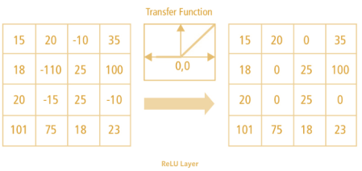
SYSTEM ARCHITECTURE
RELU OPERATION
B.Tech Bachelors Research Project: 2015-2019
30

Slide 31
SYSTEM ARCHITECTURE
POOLING LAYER
Pooling layers section would reduce the number of parameters when the images are too large.
Pooling layer consider a block of input data and simply pass on maximum value
Hence it reduces the size of the input and require no added parameters
B.Tech Bachelors Research Project: 2015-2019
31

Slide 32
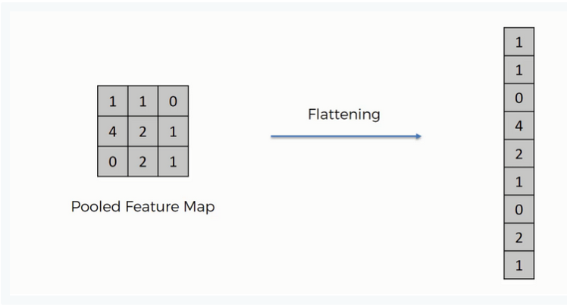
SYSTEM ARCHITECTURE
MODULE 3
FLATTENING
After finishing the previous two steps, we're supposed to have a pooled feature map by now. As the name of this step implies, we are literally going to flatten our pooled feature map into a column like in the image below.
B.Tech Bachelors Research Project: 2015-2019
32

Slide 33
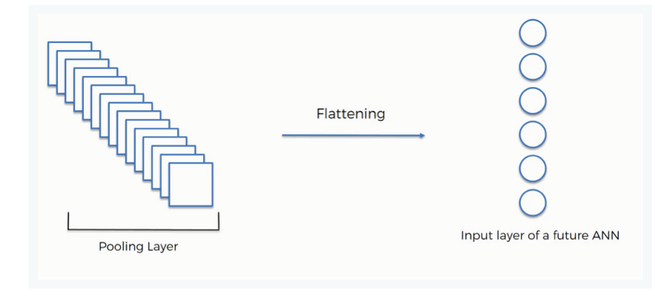
SYSTEM ARCHITECTURE
FLATTENING
The reason we do this is that we're going to need to insert this data into an artificial neural network later on.
B.Tech Bachelors Research Project: 2015-2019
39

Slide 34
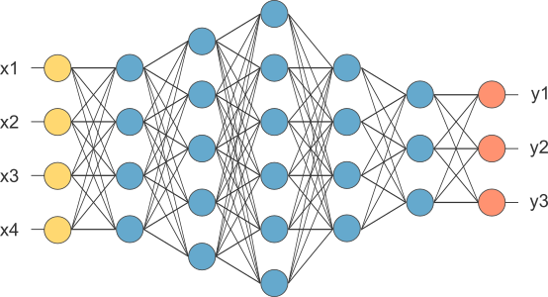
SYSTEM ARCHITECTURE
FULLY CONNECTED LAYER
The layer we call as FC layer, we flattened our matrix into vector and feed it into a fully connected layer like neural network.
B.Tech Bachelors Research Project: 2015-2019
34

Slide 35
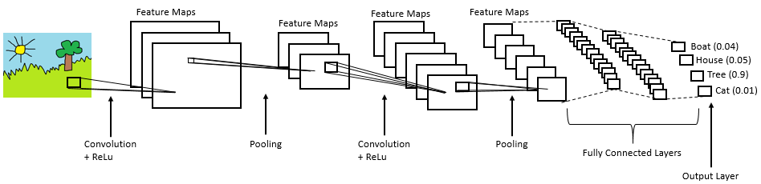
SYSTEM ARCHITECTURE
Fully connected layer is connected with output layer
B.Tech Bachelors Research Project: 2015-2019
35

Slide 36
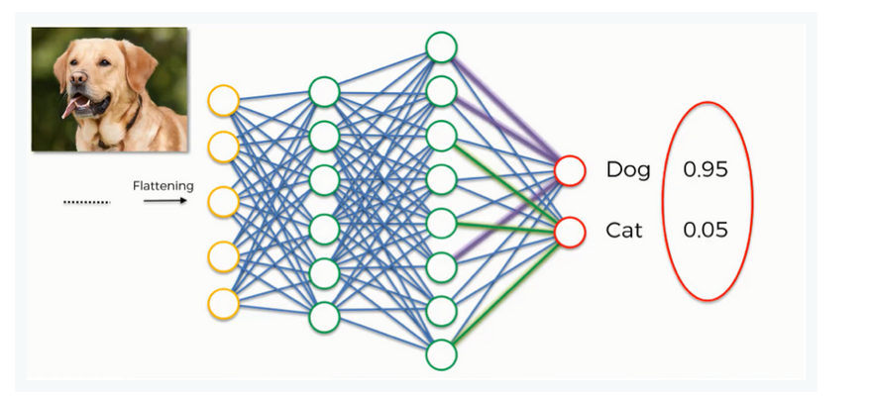
SYSTEM ARCHITECTURE
SOFTMAX FUCTION
Activation function used in the cnn.
B.Tech Bachelors Research Project: 2015-2019
36

Slide 37
SYSTEM ARCHITECTURE
Output layer
After multiple layers of convolution and padding.
output should be in the form of a class.
The convolution and pooling layers would only be able to extract features and reduce the number of parameters from the original images.
However, to generate the final output we need to apply a fully connected layer to generate an output equal to the number of classes we need.
Thus the output layer give the classified images.
B.Tech Bachelors Research Project: 2015-2019
37

Slide 38
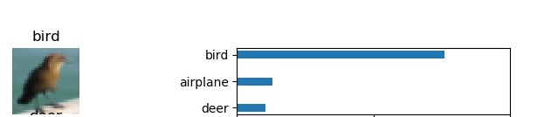
Obtained outcome
Image which are classified with its name.
The probability of image to be in the other class.

Slide 39
CONCLUSION AND FUTURE SCOPE
Implemented an image classifier using convolutional neural network, which is more efficient for image classification when comparing to the other methods.
It is usefully for classifying larger number of image with in short time.
FUTURE SCOPE
Image can be classified and keep in separate folders.
Automatic face recognition and object recognition can be used for classifying the images automatically.

Slide 40
HARDWARE REQUIREMENT
Operating system: windows 8 or later.
PROCESSOR : Intel i3 6th gen or later
RAM : MIN 2 GB
HDD : MIN 40 GB

Slide 41
SOFTWARE REQUIREMENT
Progamming language : Python 3.7
Framework : Spyder 3.3.3
Software library : Google tensor flow
Development environment : Anaconda
For visualization : matplotlib

Slide 42
REFERENCES
[1] A.LecunY, Bottou L, Bengio Y, et al. Gradient-based learning appliedto document recognition[J]. Proceedings of the IEEE, 1998,86(11):2278-2324.
[2] Cun Y L, Boser B, Denker J S, et al. Handwritten digit recognition with a back-propagation network[C] Advances in Neural Information Processing Systems. Morgan Kaufmann Publishers Inc.
[3] Hecht-Nielsen R. Theory of the backpropagation neural network[M] Neural networks for perception (Vol. 2). Harcourt Brace & Co.
1992:593-605 vol.1.
[4] Krizhevsky A, Sutskever I, Hinton G E. ImageNet Classification with Deep Convolutional Neural Networks[J]. Advances in Neural Information Processing Systems, 2012, 25(2):2012.
[5] M. D. Zeiler and R. Fergus, “Visualizing and understanding convolutional networks,” in ECCV, 2014.

Slide 43
REFERENCES
[6] N. Kalchbrenner, E. Grefenstette, and P. Blunsom, “A convolutional neural network for modelling sentences,” arXiv preprint arXiv:1404.2188, 2014.
[7] O. Abdel-Hamid, A. R. Mohamed, H. Jiang, and G. Penn, “Applying convolutional neural networks concepts to hybrid nn-hmm model for speech recognition,” in Acoustics, Speech and Signal Processing (ICASSP), 2012 IEEE International Conference on. IEEE, 2012, pp. 4277–4280.
[8] Y. LeCun, B. Boser, J. S. Denker, D. Henderson, R. E. Howard, W. Hubbard, and L. D. Jackel, “Backpropagation applied to handwritten zip code recognition,” Neural computation, vol. 1, no. 4, pp. 541–551, 1989.
[9] Y. LeCun, L. Bottou, Y. Bengio, and P. Haffner, “Gradient-based learning applied to document recognition,” Proceedings of the IEEE, vol. 86, no. 11, pp. 2278–2324, 1998.
[10]Xavier Mu ̃nozComputer Vision GroupUniversity of Gironaxmunoz@eia.udg.es, Anna BoschComputer Vision GroupUniversity of Gironaaboschr@eia.udg.es,Image Classification using Random Forests and Ferns.

Slide 44
REFERENCES
[11] Image Classification via Support Vector Machine Xiaowu Sun1, Lizhen Liu1, Hanshi Wang1, Wei Song1, Jingli Lu2 1 Information and Engineering College, Capital Normal University, Beijing 100048, P. R. China 2 Agresearch Ltd, New Zealand
[12]Unsupervised Deep Feature Extraction for Remote Sensing Image Classification Adriana Romero, Carlo Gatta, and Gustau Camps-Valls, Senior Member, IEEE.
[13] Impact of Training and Testing Data Splits on Accuracy of Time Series Forecasting in Machine Learning Ramesh Medar Vijay S. Rajpurohit Rashmi B.
[14] Preprocessing for Image Classification by Convolutional Neural Networks Kuntal Kumar Pal, Sudeep K. S IEEE International Conference On Recent Trends In Electronics Information Communication Technology, May 20-21, 2016, India. .

Slide 45
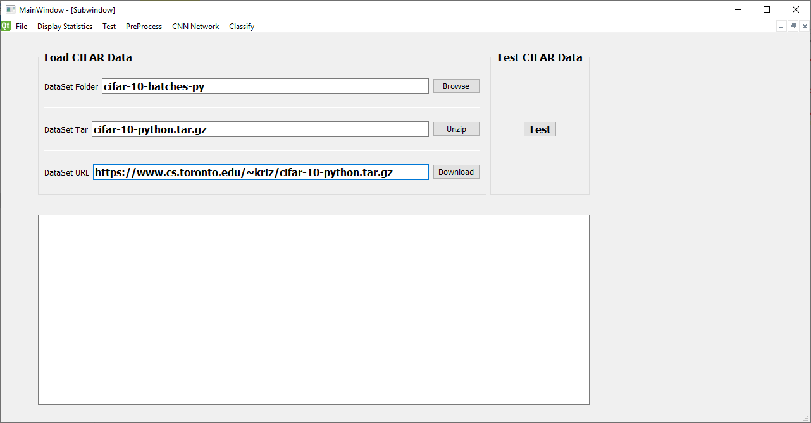
SREENSHOTS
Main window : used to give dataset input

Slide 46
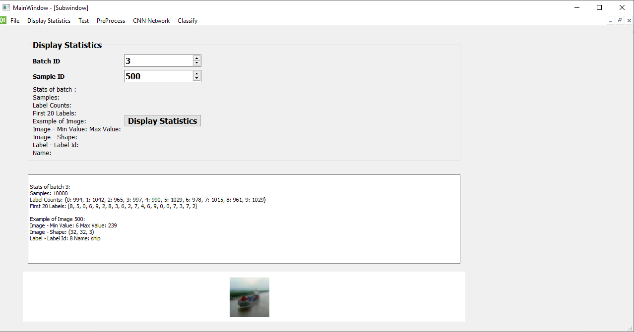
SREENSHOTS
Display statistics

Slide 47
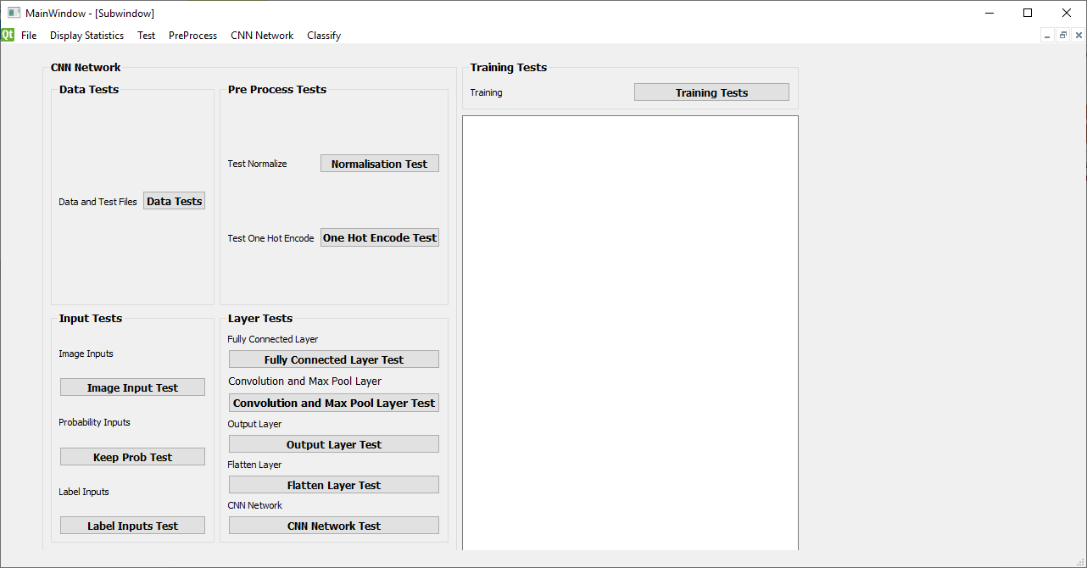
SREENSHOTS
Test window for various tests

Slide 48
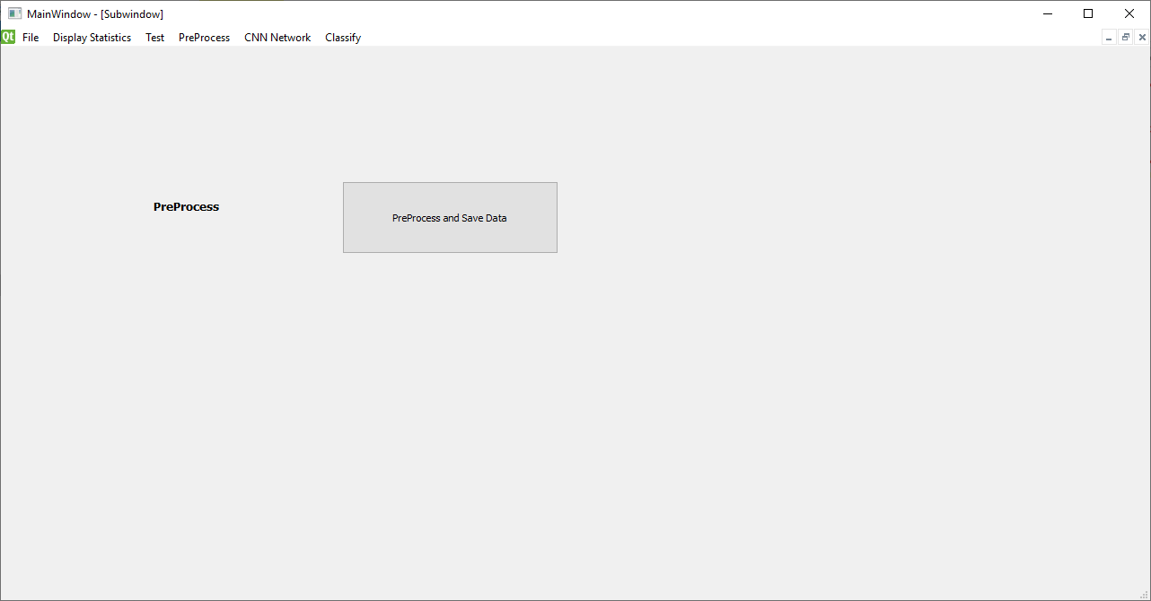
SREENSHOTS
Preprocessing

Slide 49
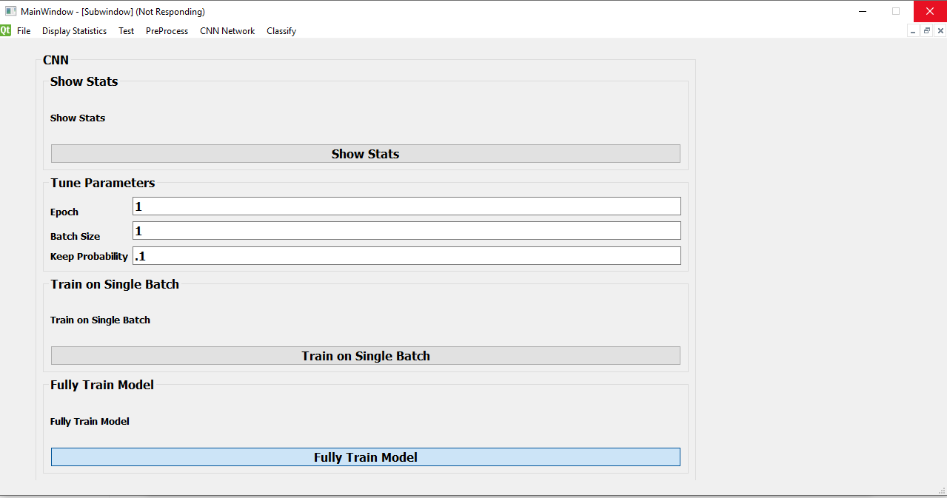
SREENSHOTS
CNN training window

Slide 50
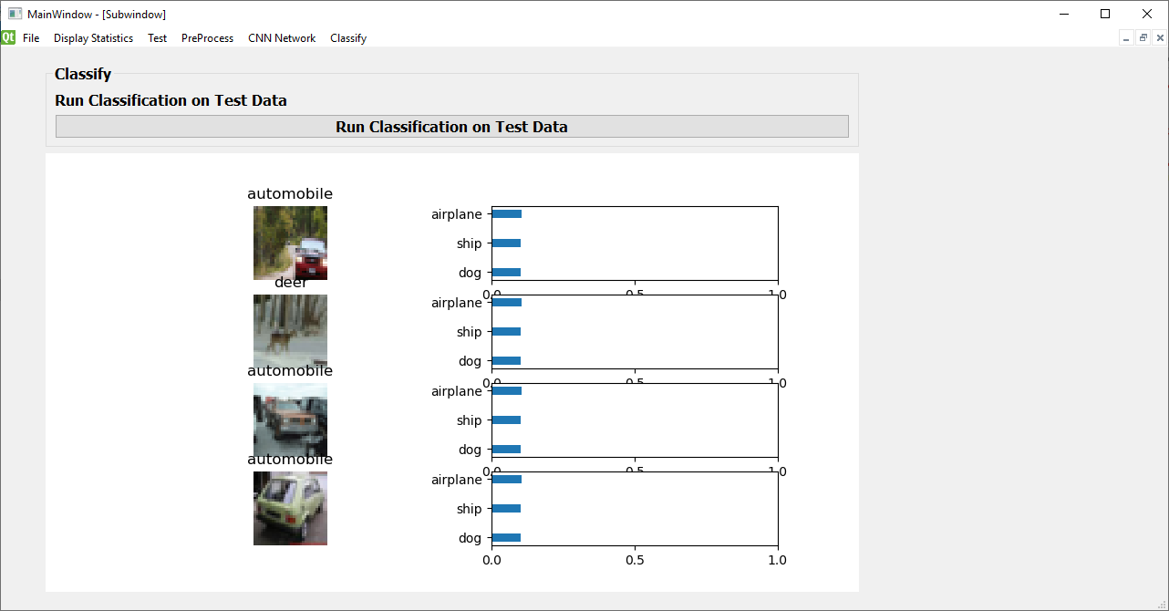
SREENSHOTS
Classification result of 2 epoch training

Slide 51
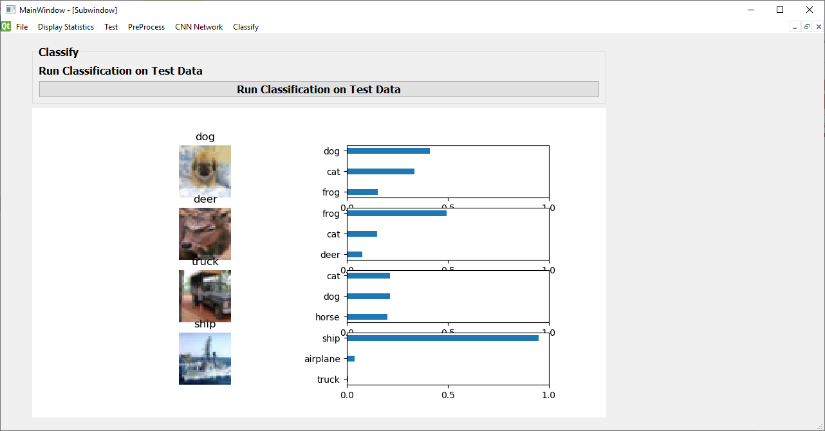
SREENSHOTS
Classification result of 10 epoch training

Slide 52
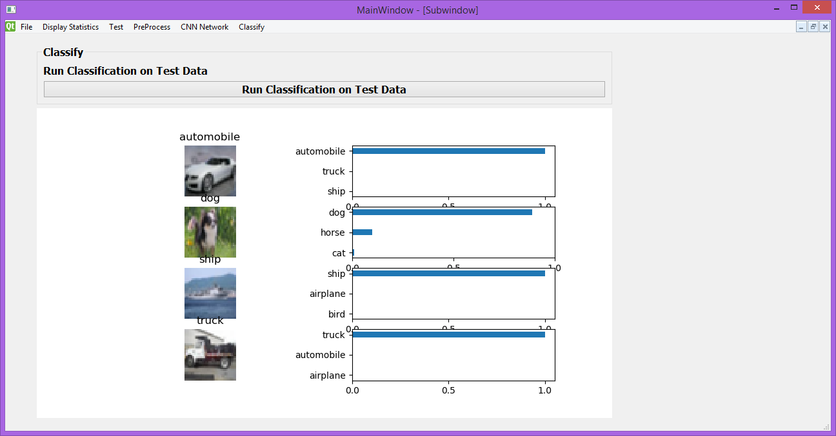
SREENSHOTS
Classification result of 75 epoch training

Slide 53
User manual
Insert the CIFAR-10 dataset to the software, Check the display statistics for the visual conformation.
Check all the test for conformation .
Train the dataset with maximum number of epoch to get a maximum accuracy in the classification.
Click the Run classification button in the classification window.
The classification will takes place.

Slide 54
Thank You

